Slide 1
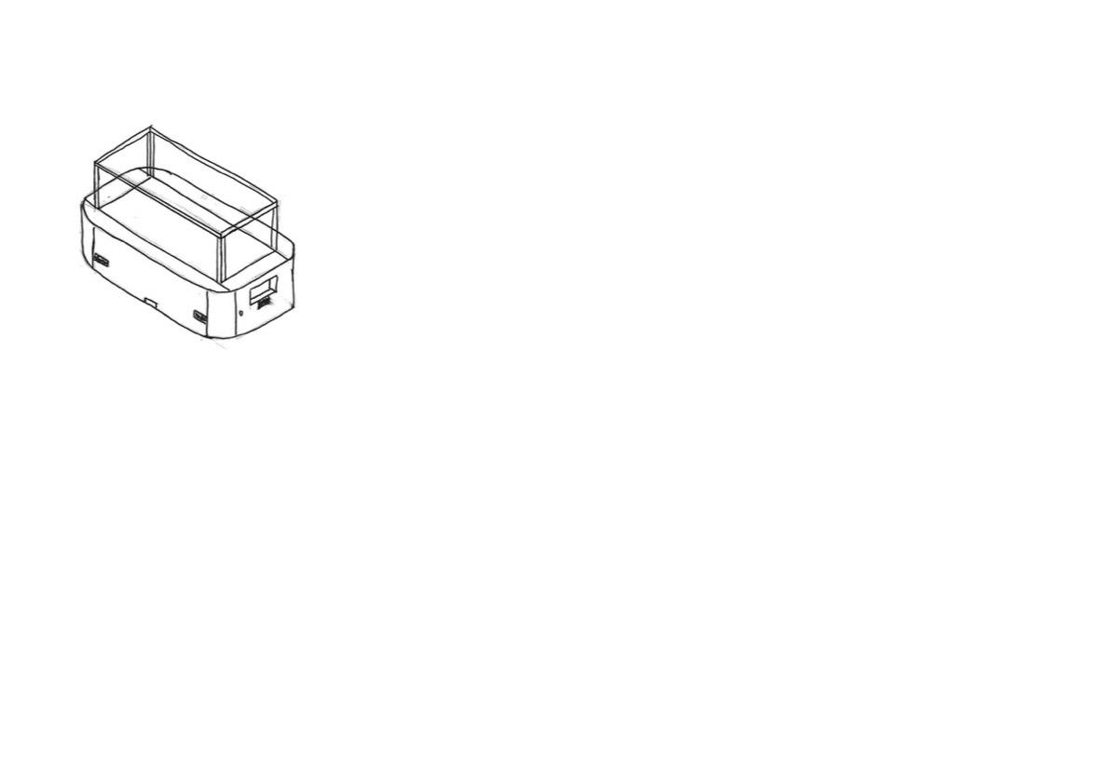
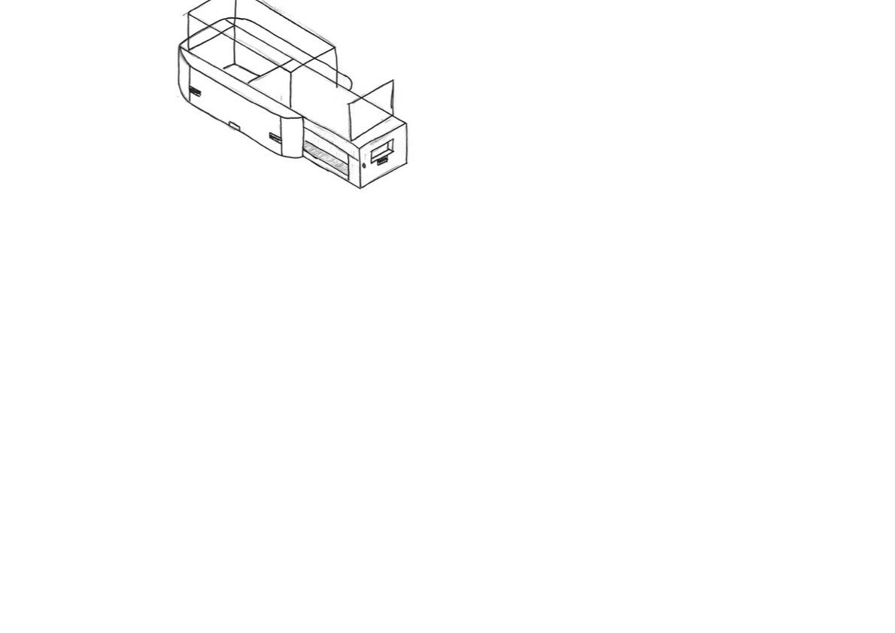
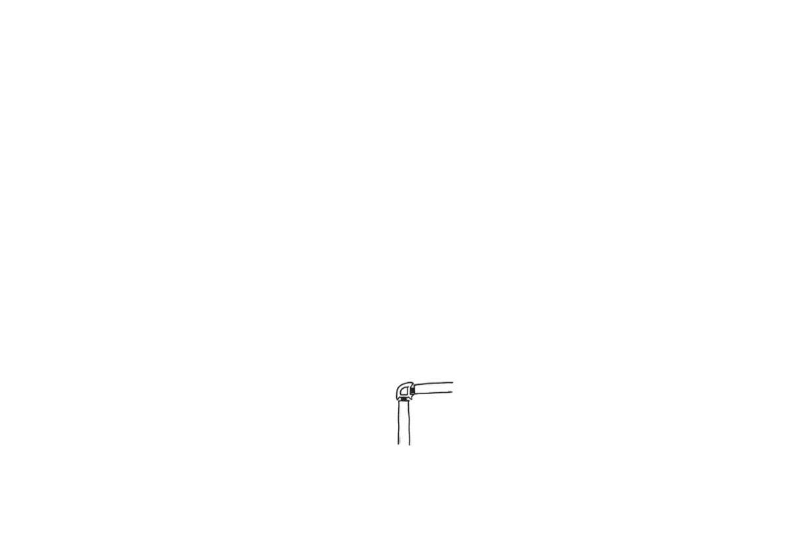
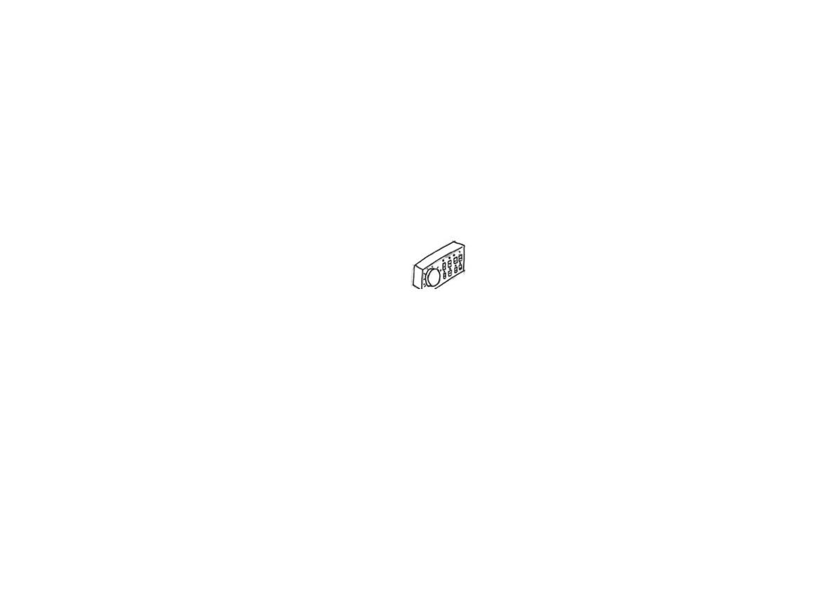
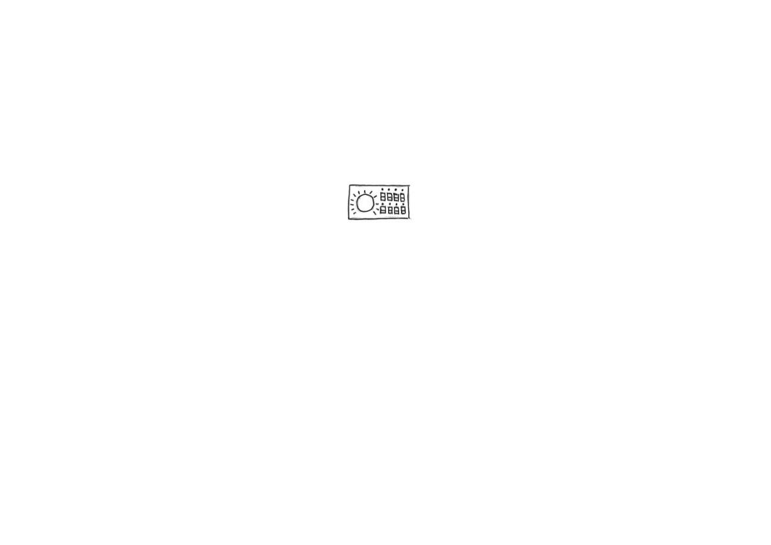

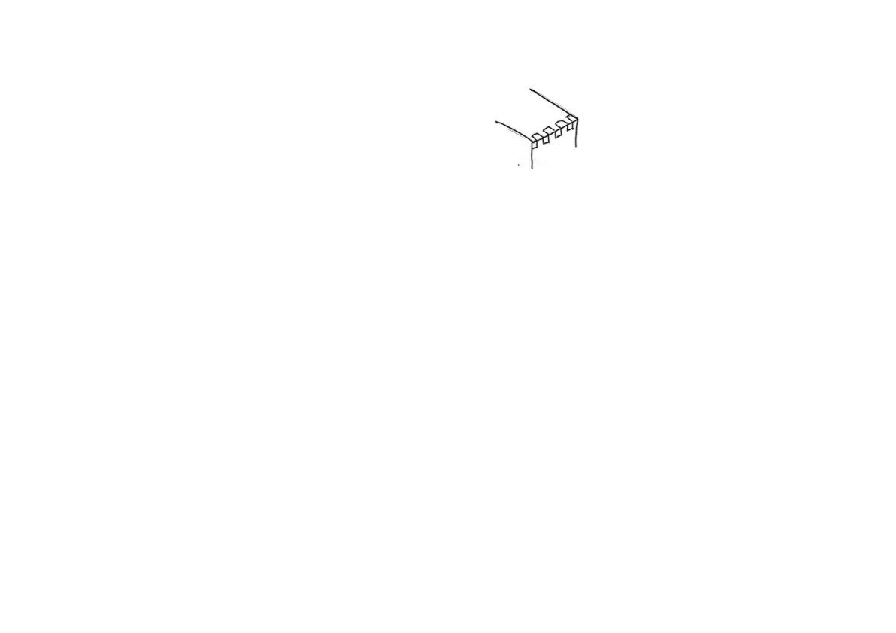



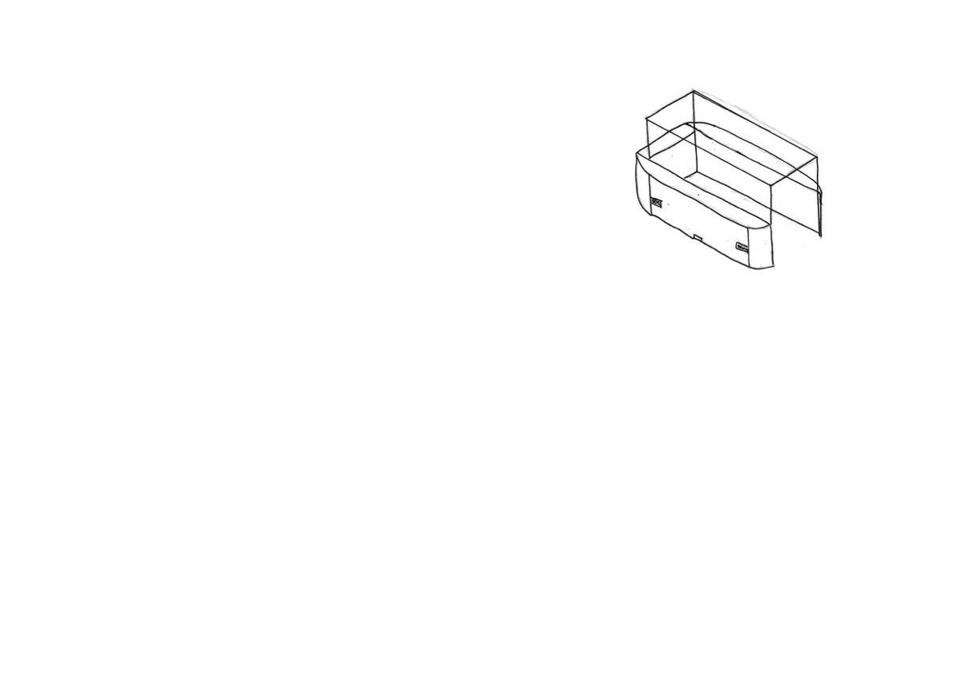
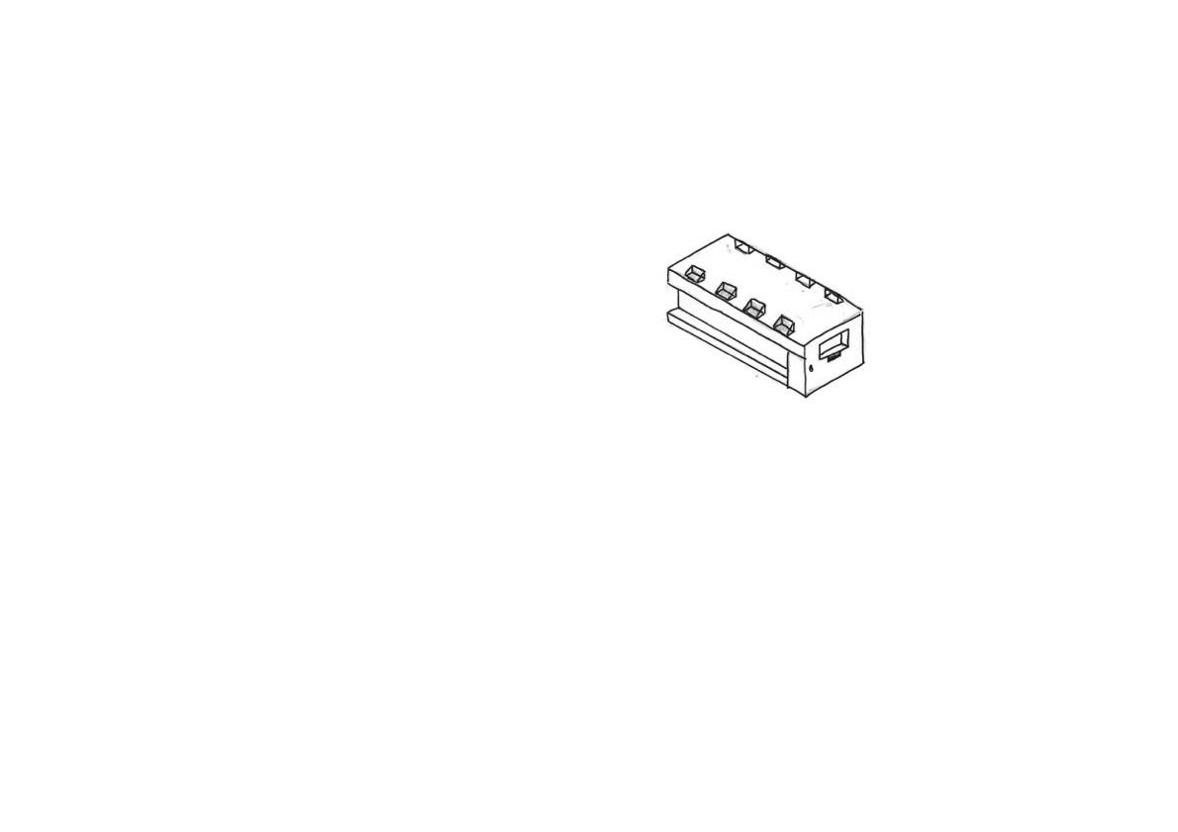
The smooth corners would be made from steam bending and then sanded down to give it a nice finish.
This is the button panel, it will not only contain the buttons but also the Arduino chipboard, to control the lights on or off via communicating to the RTC attached next to it and the motion sensors, to turn the lights and spinners off if no one is around, as requested by the design specification to reduce energy consumption.
The button panel will contain a potentiometer knob to control speed of motor. And ON/OFF switch to control whether lights are on or off.
An option for this design is that the glass panes can be joint by Glass-to-Glass steel partitioning joint
Design 1
Parts of the controller would be 3D printed. In the inside would consist of a circuit board that links to the motion sensors. An RTC would also be in here to know what time it is, and whether to turn the lights on or off
LSH, RSH, Front and Back contains 6 PIR motion sensors in total to reduce power usage.
This cabinet will be powered by mains electricity. Connected via an extension cable, and then the AC current is converted to safe 5V DC via a power adapter
Display mechanism contains a door lock to prevent theft, to provide a secure display environment for the artifact as mentioned in specification.
The wood section would be made of rubberwood to provide its integrity and joint by finger joints on its corner section. Depending on its complexity, mitre joints could even be used. And the wood section needs to be painted black as per requested by the specification.
This design consists of a drawer mechanism to access it’s inside, so it would be easier for the user to arrange the product he/she wants to put on display.
The part that slides open and closes would needs to be joint via strong housing joints. PVA glue will be used as the adhesive.
The spinner would be powered by DC electricity. A low speed high torque DC motor will be responsible for the spinning, as DC motors are save and don’t pose a risk of electrocution.
An option for this design is that the glass or acrylic panes can be joint by Silicon glue or UV glue.
The rubberwood will be covered by black veneer or black paint for aesthetic purposes. Clearcoat spray paint could be applied afterwards too.
The display side contains 8x LED lights connected to a microcontroller, ie Arduino chipboard which would be close to he button panel, which will control whether the lights are on or off.
The flat bit of the display spinner can be laser cutted with an SVG file, laser cutted acrylic have a smooth surface, and the colour could be black, giving it a minimalistic modern feel.
The display spinner’s motor flange can be 3d printed, which will then lock tightly onto the motor’s axle, allowing the spinner to spin. The flange will then be glued onto the display spinner as shown here.
Bottom side consists of railing for the drawer mechanism to slide open and close.
Notes:
Draw details on glass joints.

